Slide 1


Green Pace
Security Policy Presentation
Developer: Ed Morrow

Slide 2

OVERVIEW: DEFENSE IN DEPTH
Defense in Depth:
A layered approach to security, where multiple, overlapping layers aim to provide comprehensive security.

Slide 3
THREATS MATRIX
Higher priority threats are marked in red or yellow, and the lower in white.
Likely Most likely to occur unless the proper standards are rigorously enforced | Priority High severity or remediation cost, or both at medium
Low priority Low severity or low mediation cost | Unlikely Less likely to occur, but still quite possible

Slide 4
10 PRINCIPLES
Validate Input Data
STD-003-CPP: Guarantee that storage for strings has sufficient space for character data and the null terminator;
STD-009-CPP: Guarantee that container indices and iterators are within the valid range;
Heed Compiler Warnings
STD-001-CPP: Understand the data model used by your implementation(s);
Architect and Design for Security Policies
STD-004-JAV: Prevent SQL injection;
STD-006-CPP: Understand the termination behavior of assert() and abort();
Keep It Simple
STD-002-CCP: Do not declare more than one variable per declaration;
Default Deny
STD-010-CPP: Do not access a closed file;
Adhere to the Principle of Least Privilege
STD-010-CPP: Do not access a closed file;
STD-008-CPP: Do not access an object outside of its lifetime;
Sanitize Data Sent to Other Systems
STD-003-CPP: Guarantee that storage for strings has sufficient space for character data and the null terminator;
STD-004-JAV: Prevent SQL injection;
Practice Defense in Depth
STD-004-JAV: Prevent SQL injection;
Use Effective Quality Assurance Techniques
STD-008-CPP: Do not access an object outside of its lifetime;
STD-010-CPP: Do not access a closed file;
Adopt a Secure Coding Standard
STD-001-CPP: Understand the data model used by your implementation(s);
STD-002-CCP: Do not declare more than one variable per declaration.
STD-005-CPP: Explicitly construct and destruct objects when manually managing object lifetime;
STD-007-CPP: Exception objects must be nothrow copy constructible;

Slide 5
CODING STANDARDS
Label | Coding Standard | Severity | Likelihood | Remediation Cost | Priority | Level
STD-008-CPP | Do not access an object outside of its lifetime | High | Probable | High | P20 | L2
STD-009-CPP | Guarantee that container indices and iterators are within the valid range | High | Likely | High | P18 | L2
STD-004-CPP | Prevent SQL injection | High | Probable | Medium | P15 | L1
STD-003-CPP | Guarantee that storage for strings has sufficient space for character data and the null terminator | High | Likely | Medium | P12 | L1
STD-005-CPP | Explicitly construct and destruct objects when manually managing object lifetime | High | Likely | Medium | P12 | L1
STD-001-CPP | Understand the data model of your implementations | High | Unlikely | High | P9 | L3
STD-010-CPP | Do not access a closed file | Medium | Unlikely | Medium | P7 | L3
STD-007-CPP | Exception objects must be nothrow copy constructible | Low | Probable | Medium | P6 | L3
STD-006-CPP | Understand termination behavior of assert() and abort() | Medium | Unlikely | Medium | P5 | L3
STD-002-CPP | Do not declare more than one variable per declaration | Low | Unlikely | Low | P3 | L3

Slide 6
ENCRYPTION POLICIES
Encryption at Rest
Full disk encryption for all devices and servers;
Databases to be fully encrypted;
Restrict the most sensitive data to as few sites as possible.
Encryption in Flight
Public-key encryption technology employed for all data transmitted over a network;
Secure channels such as scp or sftp should be used, not insecure channels such as ftp.
Encryption in Use:
All data should be fully encrypted and should be decrypted only where the user’s security privileges permit;
The principles of Default Deny and Least Privilege should be observed to ensure that data be decrypted and accessed only where strictly necessary;
Access to data can be monitored by AI security analytics.

Slide 7
TRIPLE-A POLICIES
Authentication: Ensuring only permitted users may access the system
The principle of Default Deny dictates that users should be denied access to all systems until a reason for them to be granted access has been established;
Users will be granted login credentials which they must provide to access the system.
Authorization: Permission to access data or perform actions should be granted on a case-by-case basis
The principle of Least Privilege dictates that even authenticated users should not have permissions unless there is a good reason;
Authorization should be subject to regular review to ensure the policy remains aligned to the current situation.
Accounting: Monitor access and actions continuously
Security personnel should have a clear view of what data is being accessed, when, and by whom; and what data is transmitted and what actions are performed;
This role can be supplemented by AI security analytics;
This is a reactive measure that complements the proactive measures of authentication and authorization

Slide 8
Unit Testing
Unit tests can support proper observance of coding standards.
The following tests are of example of unit tests relating to coding standard
STD-009-CPP: Guarantee that container indices and iterators are within the valid range.
(The Google Test tool was used for the following examples.)

Slide 9
Collection is empty upon creation
// Test to verify that a collection is empty when created.
TEST_F(CollectionTest, IsEmptyOnCreate)
{
// is the collection empty?
ASSERT_TRUE(collection->empty());
// if empty, the size must be 0
ASSERT_EQ(collection->size(), 0);
}

Slide 10
Add a single Value to a Collection
// Create a test to verify adding a single value to an empty collection
TEST_F(CollectionTest, CanAddToEmptyVector)
{
ASSERT_TRUE(collection); // is the collection empty?
ASSERT_TRUE(collection->empty()); // if empty, the size must be 0
add_entries(1); // add entry
ASSERT_FALSE(collection->empty()); // is the collection still empty?
ASSERT_EQ(collection->size(), 1); // if not empty, the size must be 1
}

Slide 11
Resizing increases Size of Collection
// Create a test to verify resizing increases the collection
TEST_F(CollectionTest, ResizingIncreasesCollectionSize) {
// assign initial size to variable
int n = collection->size();
// resize collection
collection->resize(n + 1);
// compare new size to initial size
ASSERT_GT(collection->size(), n);
}

Slide 12
PopBack() from empty Collection is fatal
// create a test to verify that pop_back() from empty collection yields a fatal error
TEST_F(CollectionTest, PopBackFromEmptyCollectionIsFatal) {
//collection is empty
ASSERT_EQ(collection->size(), 0);
// attempt pop_back() from empty collection
EXPECT_DEATH(collection->pop_back(), "");
// collection still exists
ASSERT_TRUE(collection);
}

Slide 13
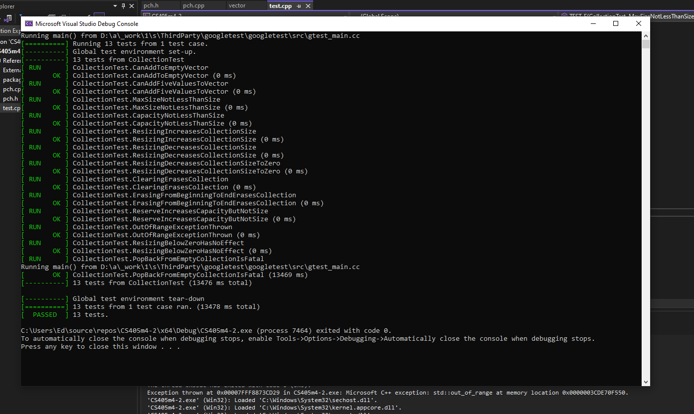
Test Suites
The previous tests (successful completion shown above) would form part of
a more comprehensive test suite.

Slide 14

AUTOMATION SUMMARY

Slide 15
TOOLS
Build stage: verify that all libraries and repositories are still trusted and actively maintained (OWASP Dependency-Check);
Verify and Test: develop unit tests to verify code integrity (GoogleTest);
Transition and Health Check stage: Penetration testing to determine the system’s robustness in the face of a simulated attack (Astra Pentest);
Monitor and Detect stage: Automated log collection, analysis and intrusion detection to facilitate rapid releases of security patches and updates (ManageEngine EventLog Analyzer);
Defense in Depth achieved by creating multiple opportunities to identify any given issue.

Slide 16
RISKS AND BENEFITS
Wait to address security later:
Time-to-market may be reduced;
Reputational damage could result from a system with well-known and avoidable security vulnerabilities;
Retroactively applying security protocols could take longer overall than having them baked into the system;
Much slower learning curve dealing with emerging threats as system will still be combatting more well-known threats
Act now
Security will be central to all developments;
Establishing security protocols now will allow better adaptability in the face of new threats in the future;
Identifying security vulnerabilities before anybody else does will help to protect the company’s reputation
Greater time and manpower demands to implement the security policy

Slide 17
RECOMMENDATIONS
Implement the security Policy as swiftly and comprehensively as possible;
Utilize automation tools to support the Policy’s successful implementation;
Leverage automated log collection and analysis to aid in accounting as part of the AAA policy;
Look for potential vulnerabilities not addressed by the Policy as it is;
Request feedback from developers on additions or changes to the Policy that may be necessary;
Conduct penetration testing and continually reevaluate the Policy’s efficacy in light of new developments.

Slide 18
CONCLUSIONS
The Policy is provisional and will need to be reexamined in light of future developments and emerging threats;
e.g. The Alibaba Group (Hope, 2021) data leak was an ‘inside job’: how can we protect against such possible attacks in the future?
The Policy can only be as successful as its implementation, so all developers must be proactive and accountable in applying the standards and adhering to the principles;
Where feasible, the Policy should be retroactively applied to existing codebases;
The results of penetration testing will inform future changes or enhancements to the Policy.

Slide 19
REFERENCES
Hope, A. (2021, June 25). Web Scraping on Alibaba’s Taobao Resulted in Data Leak of 1.1 Billion Records. CPO Magazine. https://www.cpomagazine.com/cyber-security/web-scraping-on- alibabas-taobao-resulted-in-data-leak-of-1-1-billion-records/

